Slide 1

Return of the Exiled: Where is my Sandwich?
CS 3383 SA Presentation

Slide 2
Introduction - Return of the Exiled: Where is my Sandwich?
We are creating a roguelike rpg game themed after “Path of Exile”. The player will start out as a forlorn exile who seeks revenge against the evil tyrant of the land, Jared. As they defeat Jared’s minions they will gain fame and fortune, eventually facing off against Jared himself.

Slide 3
Our Team
Trevor DeVries - TL2
Yoshi Wiener - TL2+
Eric Johnson - TL3
Haddie Meyer - TL4
Miles Kison - TL5
Torry Chmelik - TL6
Andersen Westphal - TL1

Slide 4
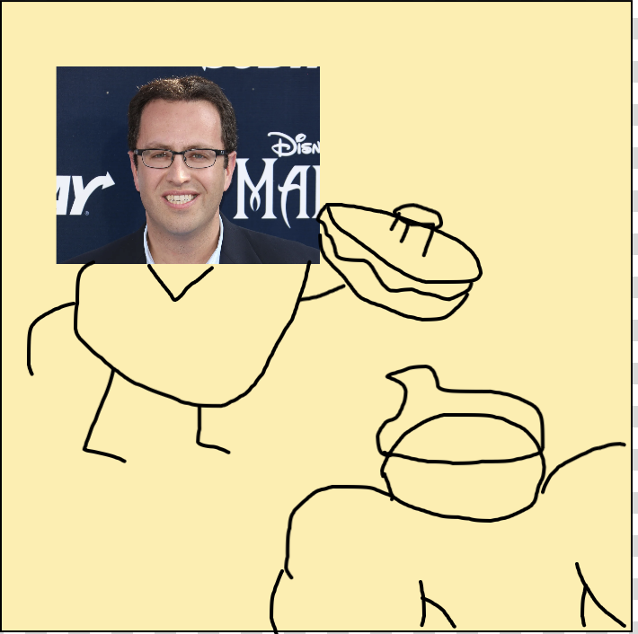
Scene 1
Action: You wake to Jared eating your sandwich that you had made the day pior after being exiled from Sublandia.
Dialogue: Player calls out for his sandwich but it is too late
Note: You are a unnamed exiled that is trying to start a new.
Miles Kison

Slide 5
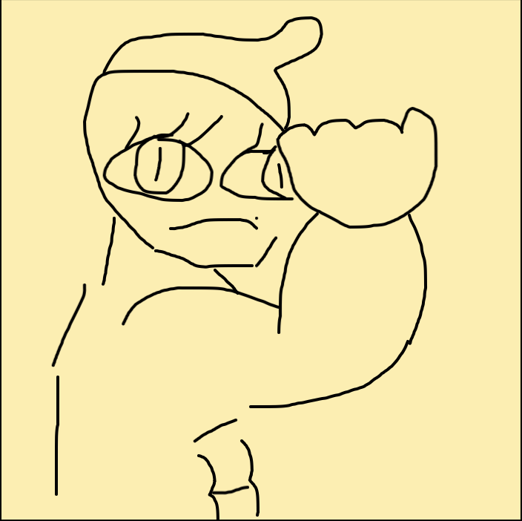
Scene 2
Action: With little dough to your name and no connection holding you back you vow to get revenge on Jared
Dialogue: None
Note: Your journey will begin with the tutorial taking you through basic combat and ablitiies that you will use on your way to confront Jared
Miles Kison

Slide 6
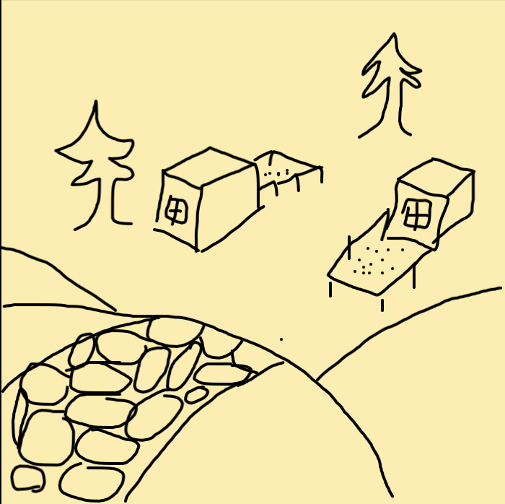
Scene 3
Action: The first place you come upon is Footlong Meadow. Not sure where Jared’s castle is you ask the local tavern and find out that the town is being ravaged by white bunnies. If you help out these 11 inch children they will guide you to the castle.
Dialogue: basic NPC dialog
Note: This will be the first level. Your first true combat zones will be found here. The area will include a village and a forest area where the bunny enemies will be found attacking the village
Miles Kison

Slide 7
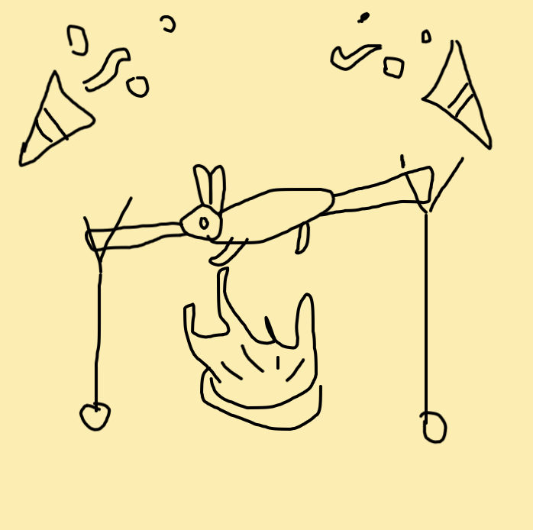
Scene 4
Action: You defeat the bunnies after a brutal battle and celebrate with the 11 inch children. They praise you and hold a fest in your honor.
Dialogue: Shopkeeper mumbling about trades to player
Note: The village will open up and all the shops will open back up. This will give the character a chance to buy and sell weapons.
Miles Kison

Slide 8
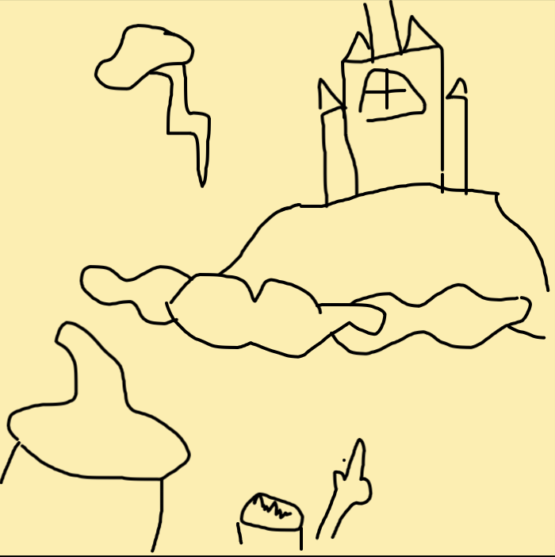
Scene 5
Action: A child now guides you to Jared’s castle. Along the way you encounter many of Jared’s condiment creatures
Dialogue: None
Note: This will be a combat section at the start of level two where the terrain will change from nice fields to lava filled casums.
Miles Kison

Slide 9
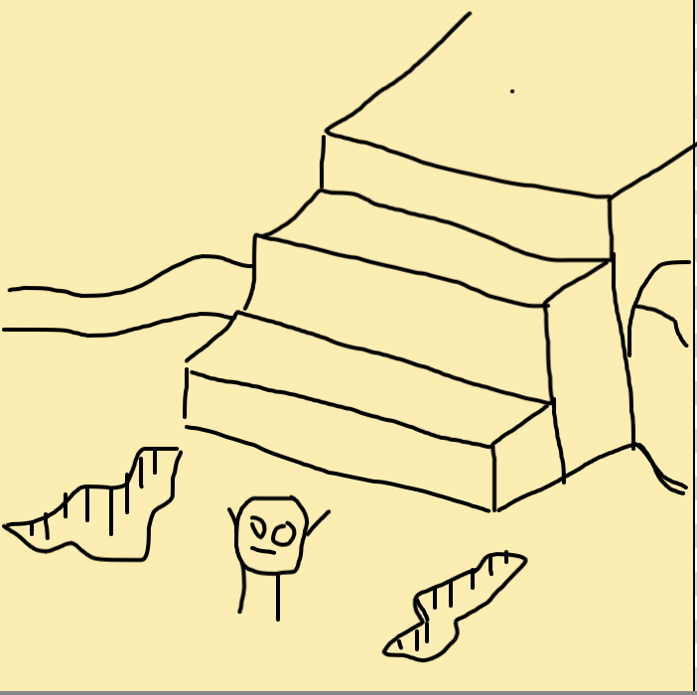
Scene 6
Action: You find yourself now in the Marinara Steppes where the child can take you no longer. You must fight through fiery meatballs and jump over marinara streams. After killing all the tasty enemies you finally make it to the steps where you can climb to the top.
Dialogue: None
Note: This will be the bulk of the second level with combat zones aplenty with lava (marinara) streams on blackened ground. Little to no foliage and enemies at every turn.
Miles Kison

Slide 10
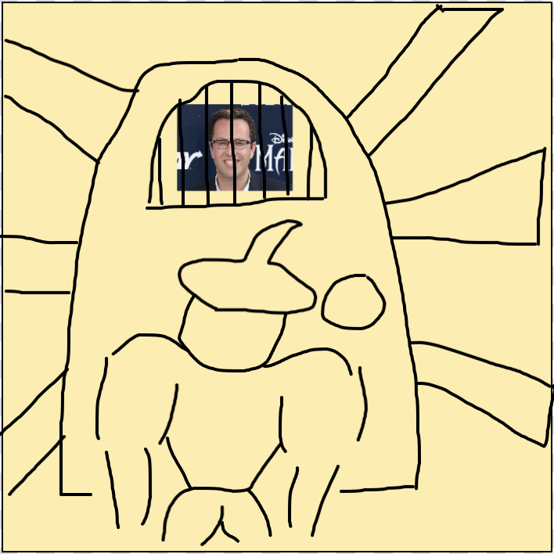
Scene 7
Action: You enter Jared’s castle expecting a fight but instead it is empty. You make your way through the long halls full of bat screeches and torches until you find the door into the main chamber rooms.
Dialogue: shopkeepers mumbles to players about trades
Note: After a long fight this will be a moment to relax and take in the dark scenery.
There will be one last shop to optimize your gear at. Around you are dark hallways with wooden doors with torches on every corner.
Miles Kison

Slide 11
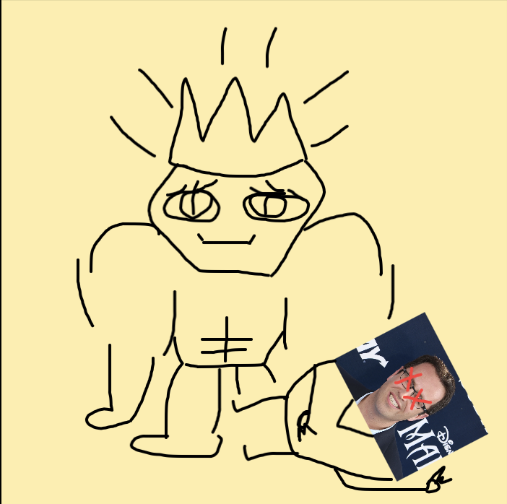
Scene 8
Action: After a viscous fight with Jared you kill him finally taking your revenge. With there being a power gap you decide to take the throne to establish a new Law in Sublandia “No man shall ever eat another man’s sandwich”
Dialogue: final message from Jared cursing the player
Note: This will be the final boss fight full of fun surprise abilities. Once defeated you will have reached the end condition and won the game.
Miles Kison

Slide 12
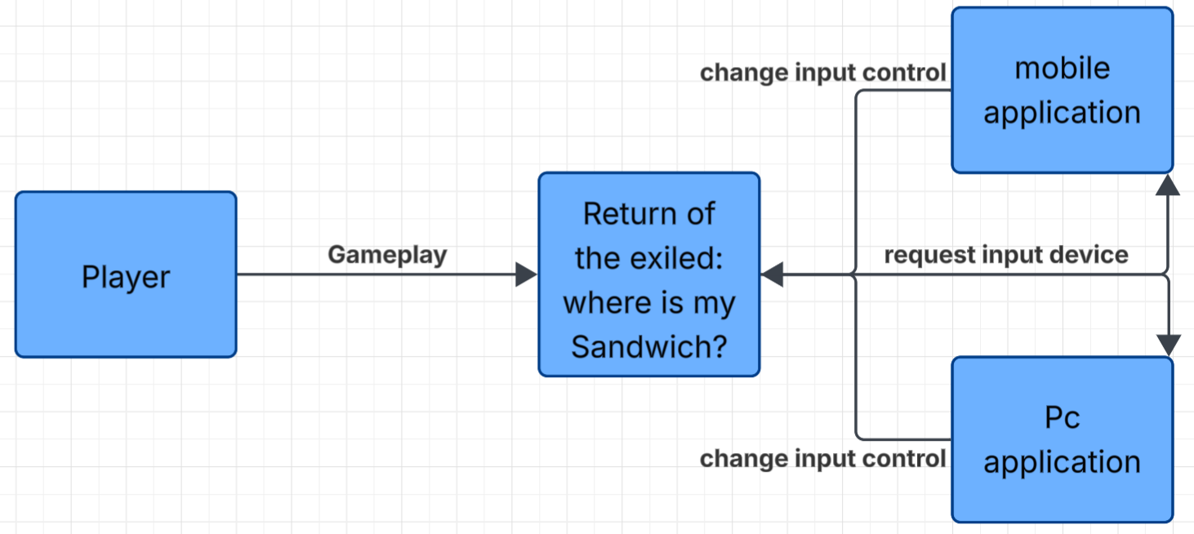
Context Diagram
Yoshi Wiener

Slide 13
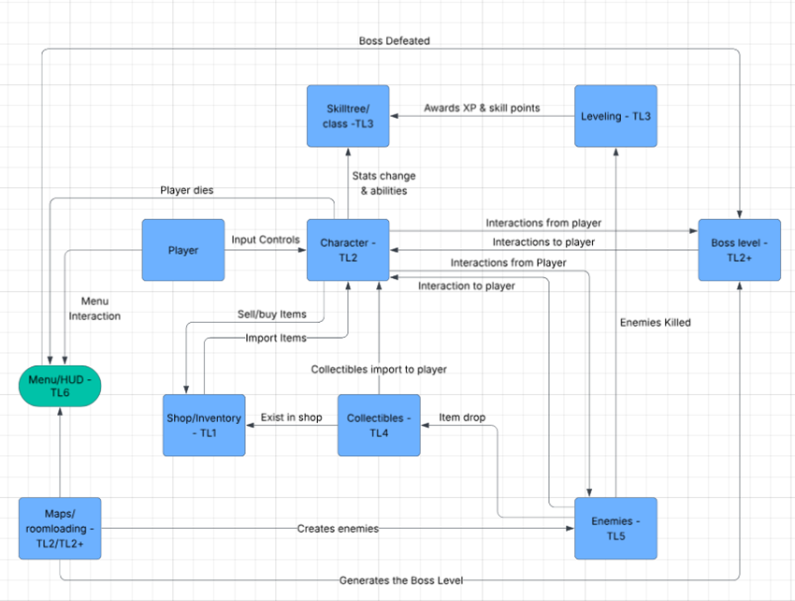
Diagram 0
Yoshi Wiener

Slide 14
Global Use Case - Regular play
Level:
Load the level
Enemies:
Move toward/attack player
Player:
Move/fight enemies
Weapon:
Drain enemy health/player cooldown
Player:
Move on
Inventory:
Add loot
Enemy:
Dies and drops loot
Haddie Meyer

Slide 15
Global Use Case - Shop Interaction
Level:
Loads the shop level
Player:
Buy/Sell using loot
Player:
Enters shop
Andersen Westphal

Slide 16
Global Use Case - Final Boss
Player:
Enters the boss zone
Level:
Load Boss level
Boss:
Move towards/fight Player
Player:
Fights Boss
UI:
Load Victory Screen
Player:
Wins
Weapon:
Drain boss health/player cooldown
Yoshi Wiener

Slide 17
Trevor De Vries
My name is Trevor De Vries
My role will be making the first map, the character, the movements of the character, and the death/respawn features of the character.
All of these features are high priority.
Walk you through my use case and class diagrams
Estimate the complexity of the work relative to the other features
Answer any questions
Trevor De Vries

Slide 18
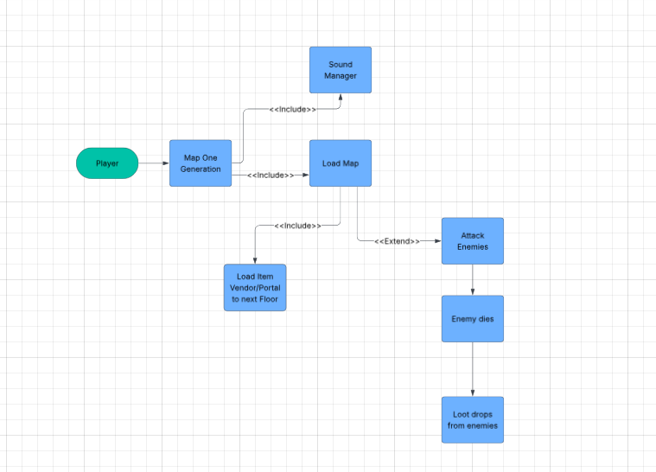
Map One Diagram
Trevor De Vries

Slide 19
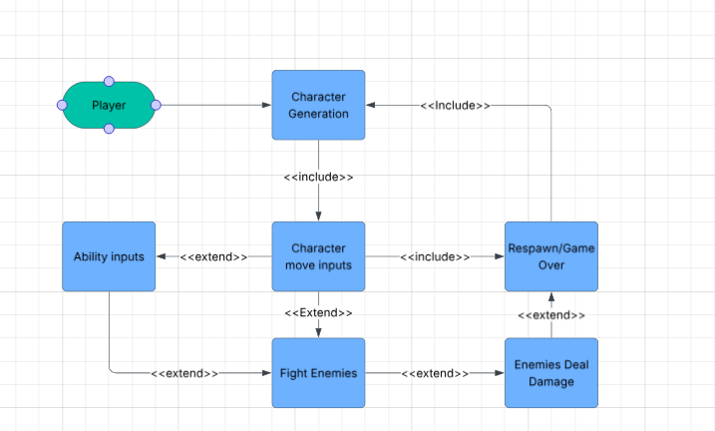
Character Diagram
Trevor De Vries

Slide 20
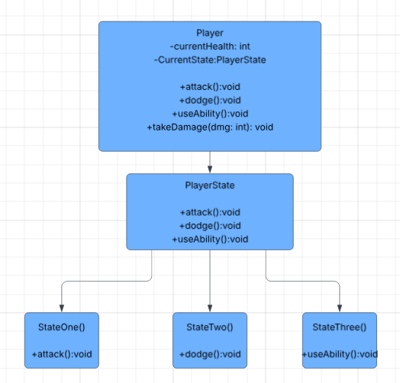
Class Diagram
Trevor De Vries

Slide 21
Boss-Level and Map 2
My feature is the Boss-level and the Map 2 design of the second Map
The boss-level has high priority, the Map 2 is nice to have
Overall Complexity (7/10)
Yoshi Wiener

Slide 22
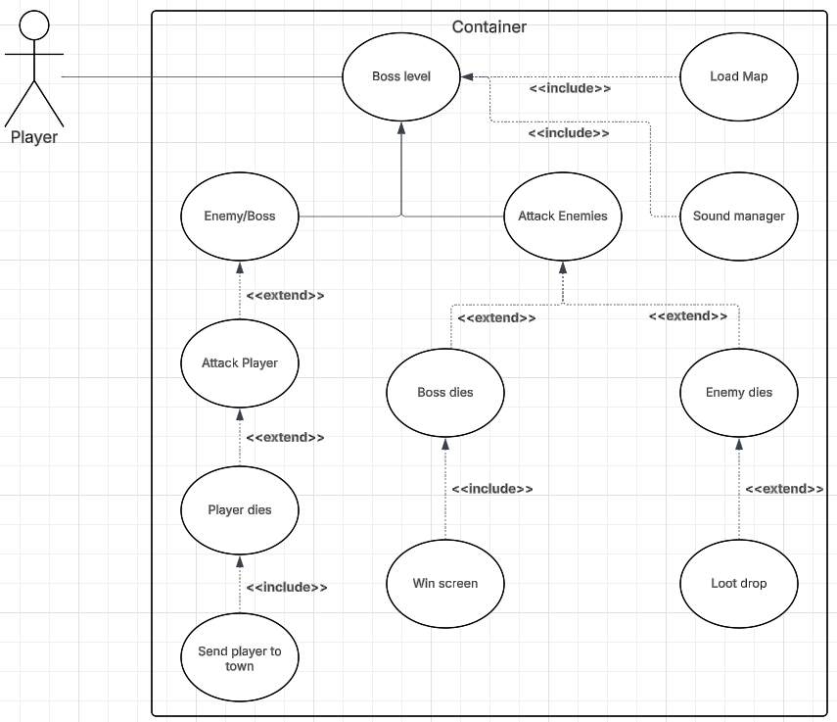
Use case diagrams
Boss-level
Yoshi Wiener

Slide 23
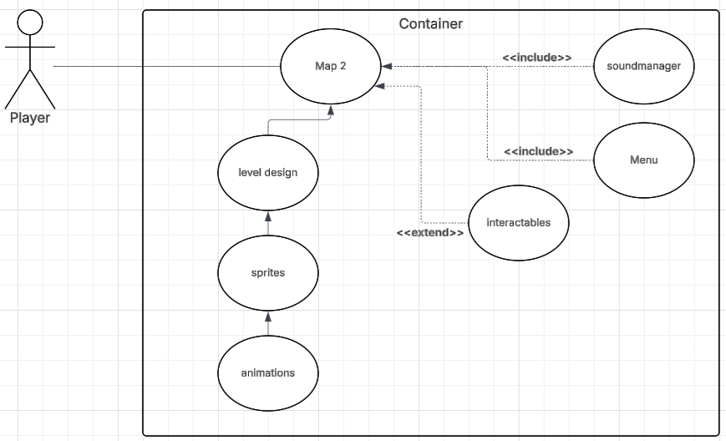
Use case diagram
Map 2
Yoshi Wiener

Slide 24
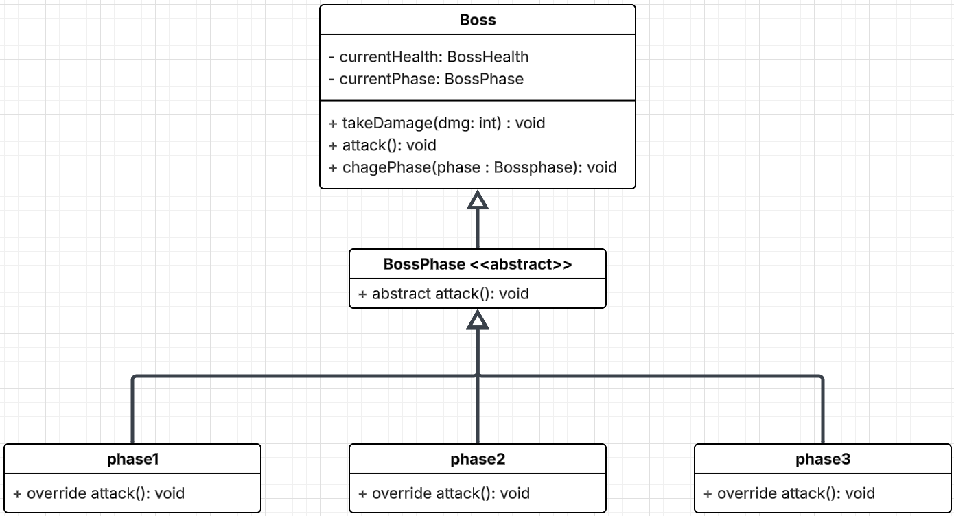
Class diagram
Yoshi Wiener

Slide 25
Eric Johnson
Skill tree with 3 classes
Fighter, Ranger, Mage
Player picks starting class
Starting class decides where on the skill tree you start
Medium priority because it is how the player levels up
Eric Johnson

Slide 26
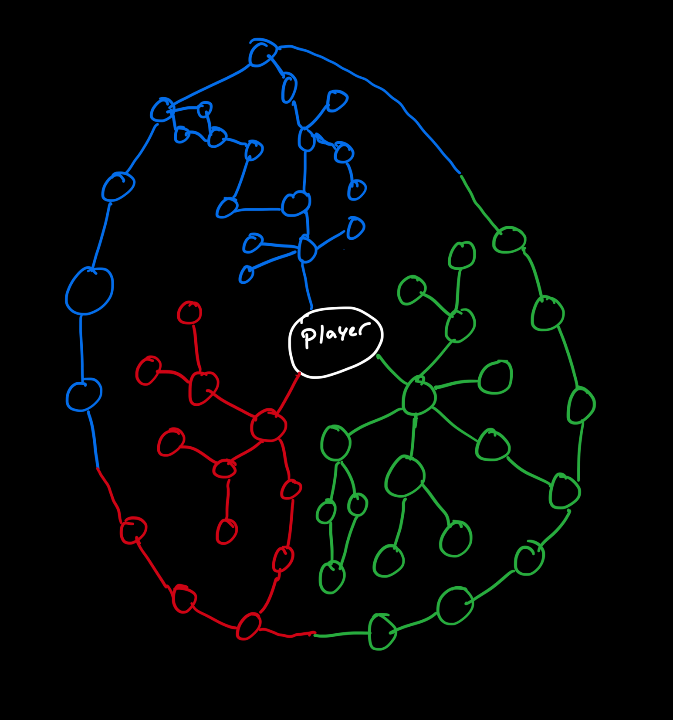
Eric Johnson
Eric Johnson

Slide 27
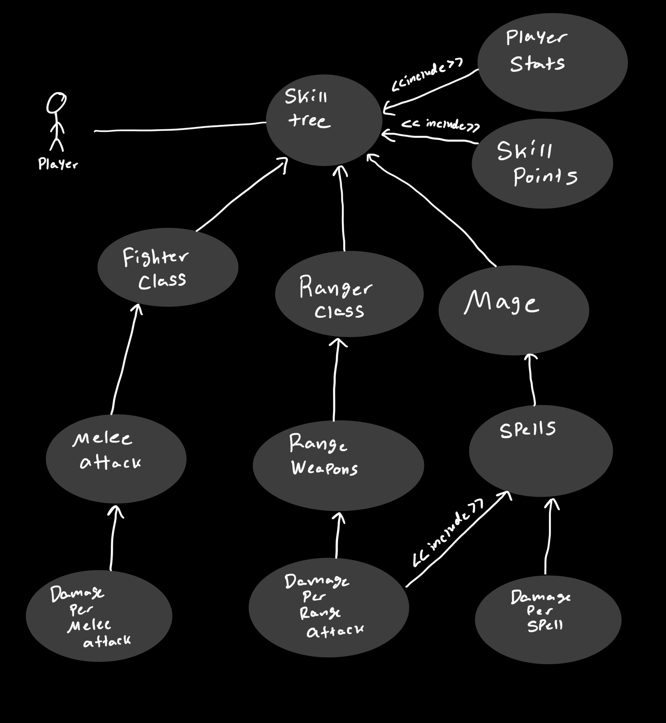
Eric Johnson
Eric Johnson

Slide 28
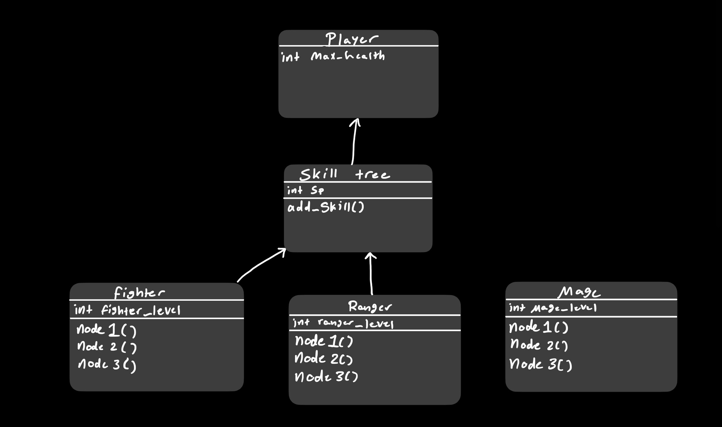
Eric Johnson
Eric Johnson

Slide 29
Shop and Inventory Interface
My Feature is the shop and player inventory interfaces.
My feature is a high priority because it is needed to progress the player with better items throughout their journey
Andersen Westphal

Slide 30
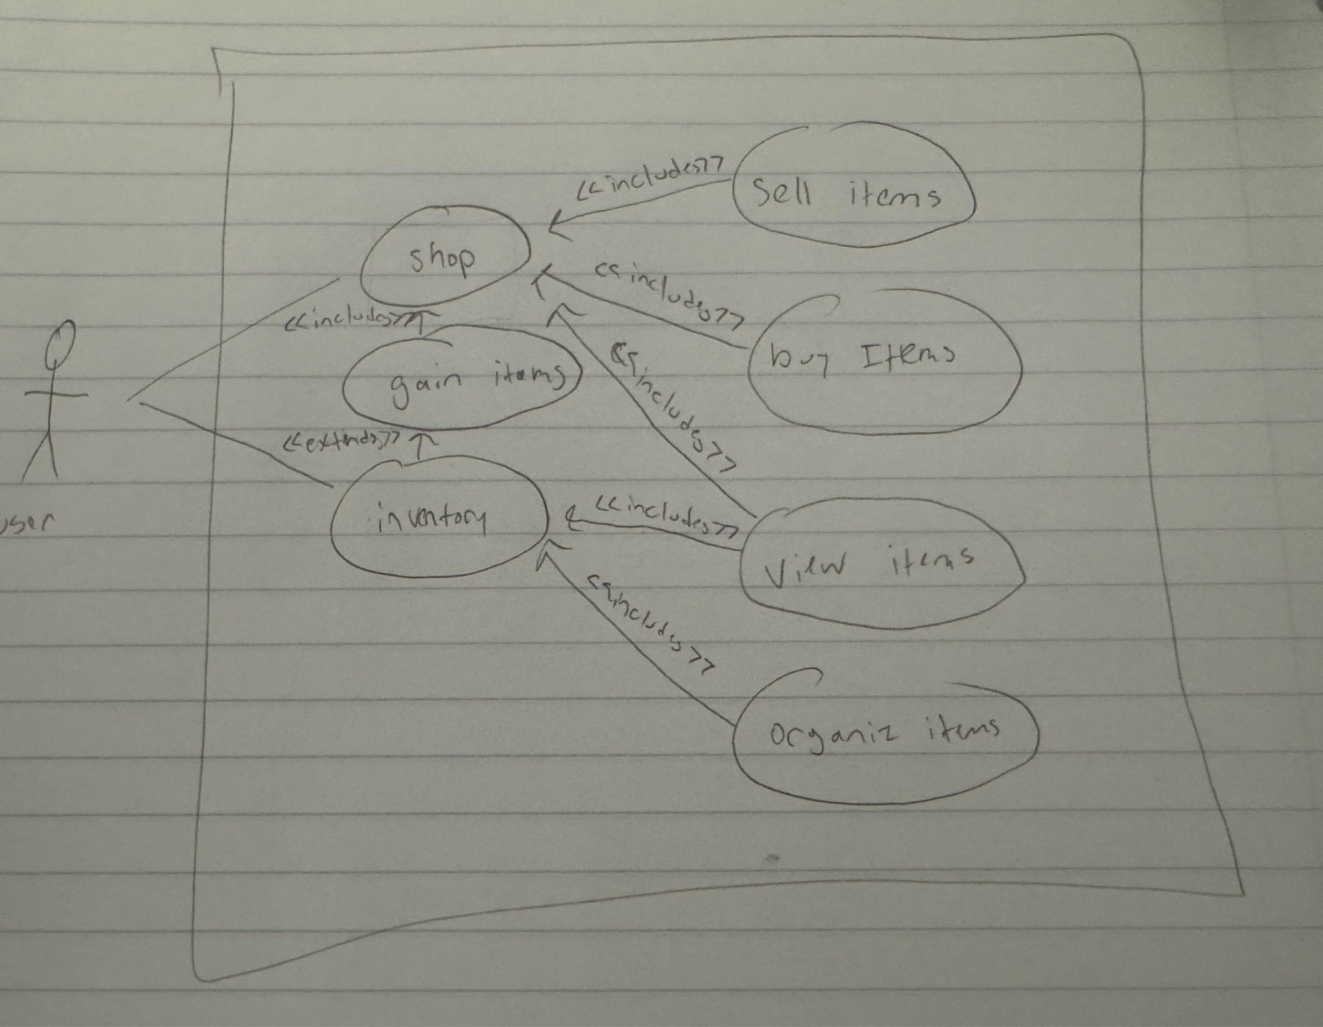
Use Case
Andersen Westphal

Slide 31
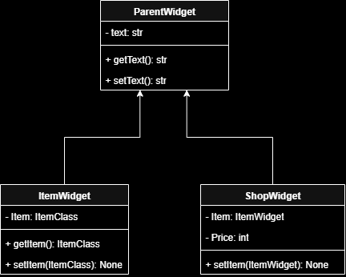
Class Diagrams
Andersen Westphal

Slide 32
Haddie Meyer - Collectibles
Items
Health potions
Weapons
“Dough”
Enemy Drop Mechanics
Item types and rarity based on enemy type and player level
Inventory Checks
Inventory too full -> item still exists in world
Medium Priority
Average Complexity

Slide 33
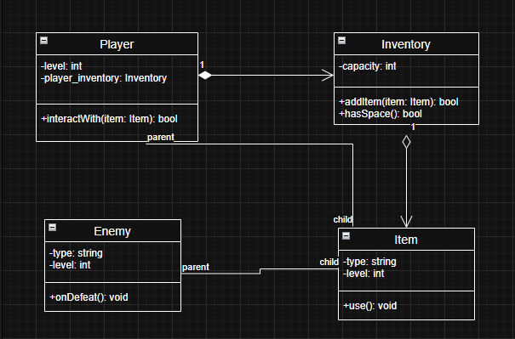
Class Diagram
Haddie Meyer

Slide 34
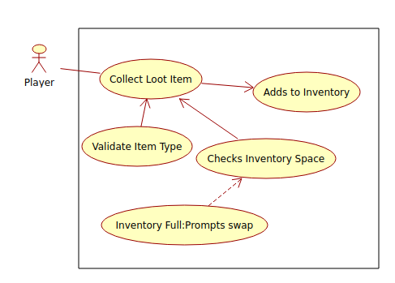
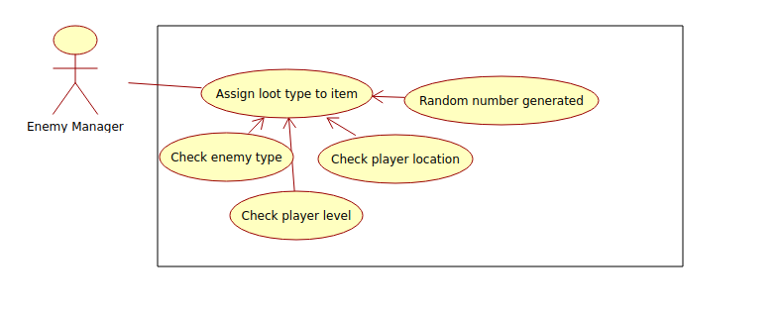
Use Cases
Haddie Meyer

Slide 35
Torry Chmelik (Team Lead 6)
In Charge Of:
Player HUD
Main Menu
Priority:
Main Menu is a Medium to High Priority because it is needed in order to navigate the games levels and give the player the ability to enter in and out of Gameplay
Player HUD is Low to Medium Priority because it serves as a way to inform the player about their current status/situation in game
Torry Chmelik

Slide 36

Player HUD (Heads Up Display)
A player’s HUD provides on-screen information such as health, ammo, objectives, and status so the player can quickly understand their situation and make decisions without leaving the game world.
Torry Chmelik

Slide 37

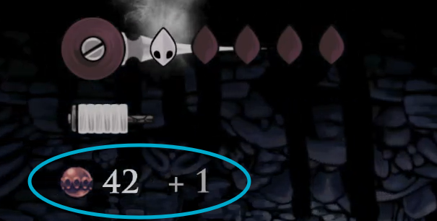
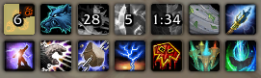
Role of Our HUD
Display Health
Display Money Count
Display Ability and Ability Cooldowns
Overall Complexity (4/10)
Torry Chmelik

Slide 38
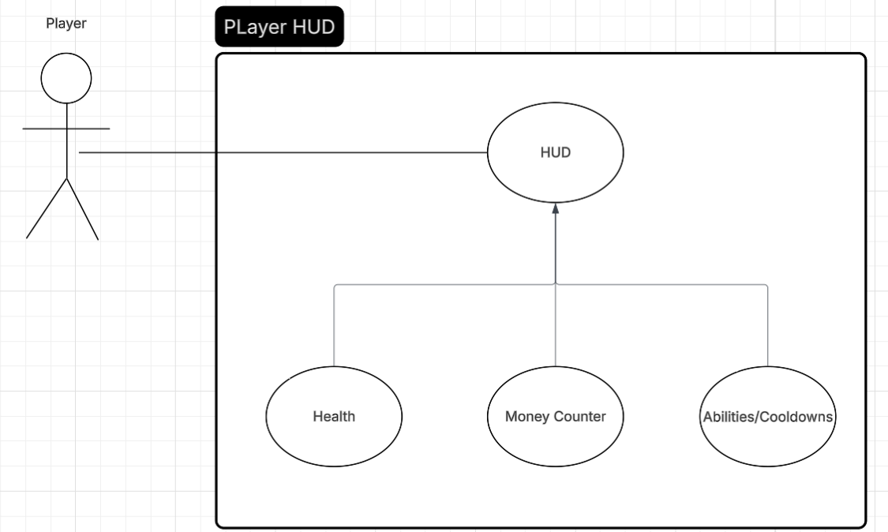
HUD Use Cases
Torry Chmelik

Slide 39
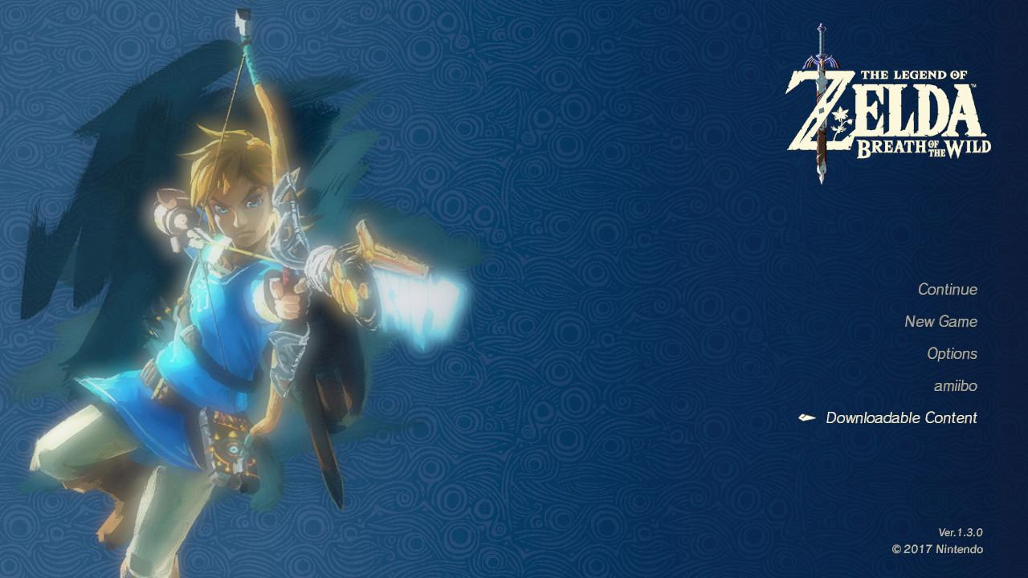
MAIN MENU
The main menu serves as the central hub of a game, it allows players to begin playing, continue from saves, adjust settings, and access additional features before entering the gameplay
Torry Chmelik

Slide 40
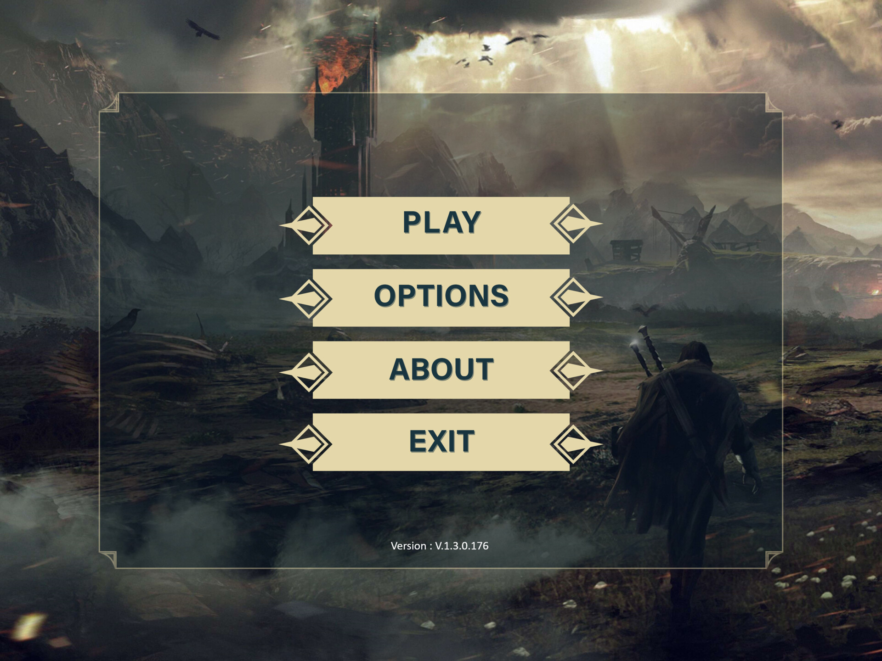
Role of Our Main Menu
Allow the player to start the gameplay when ready
Allow the player to exit the program whenever
Allow the player to access information on how to play
Overall Complexity 2.5/10
Torry Chmelik

Slide 41
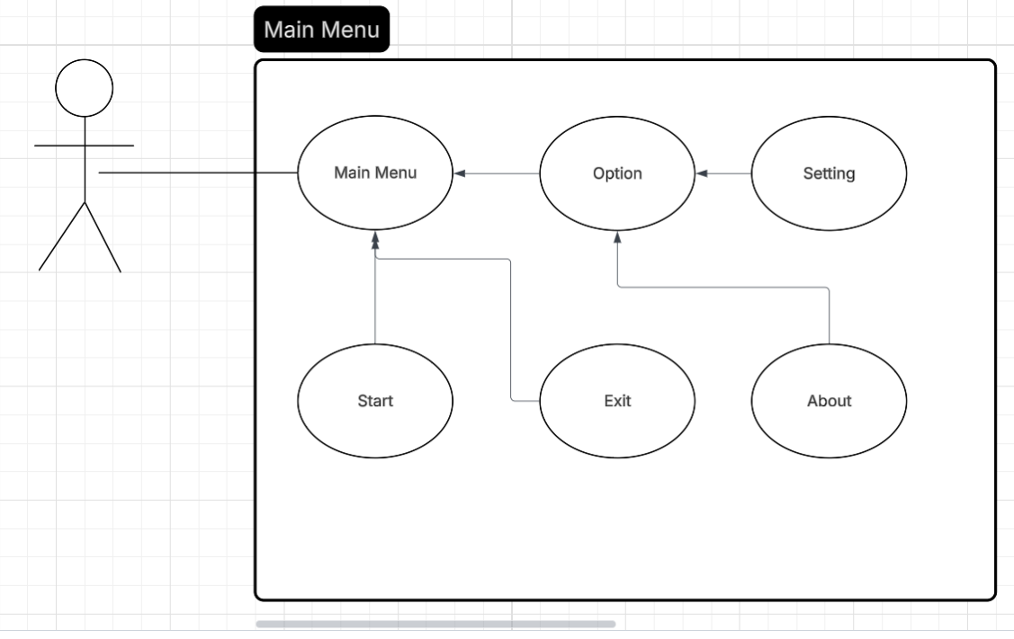
Menu Use Cases
Torry Chmelik

Slide 42
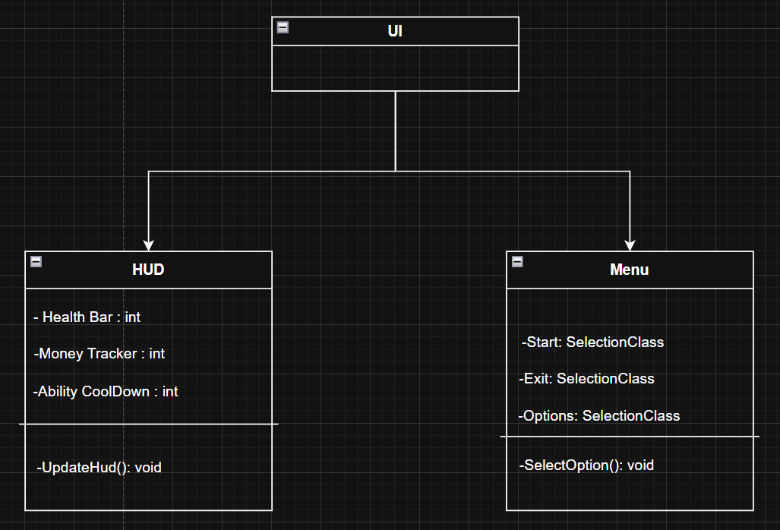
Class Diagram
Torry Chmelik

Slide 43
Enemies and Enemy Spawners
Enemies are an what gives our game a game loop with combat
Very important to the game and will be high complexity
Alongside this will be the spawner that will be in every combat zone should be a smaller feature medium complexity
With both of these in tandem the game will have a loop of combat zones that the player will enter and then have enemies spawn and attempt to kill the player. Killing the enemies will drop loot helping to upgrade the player.
Miles Kison

Slide 44
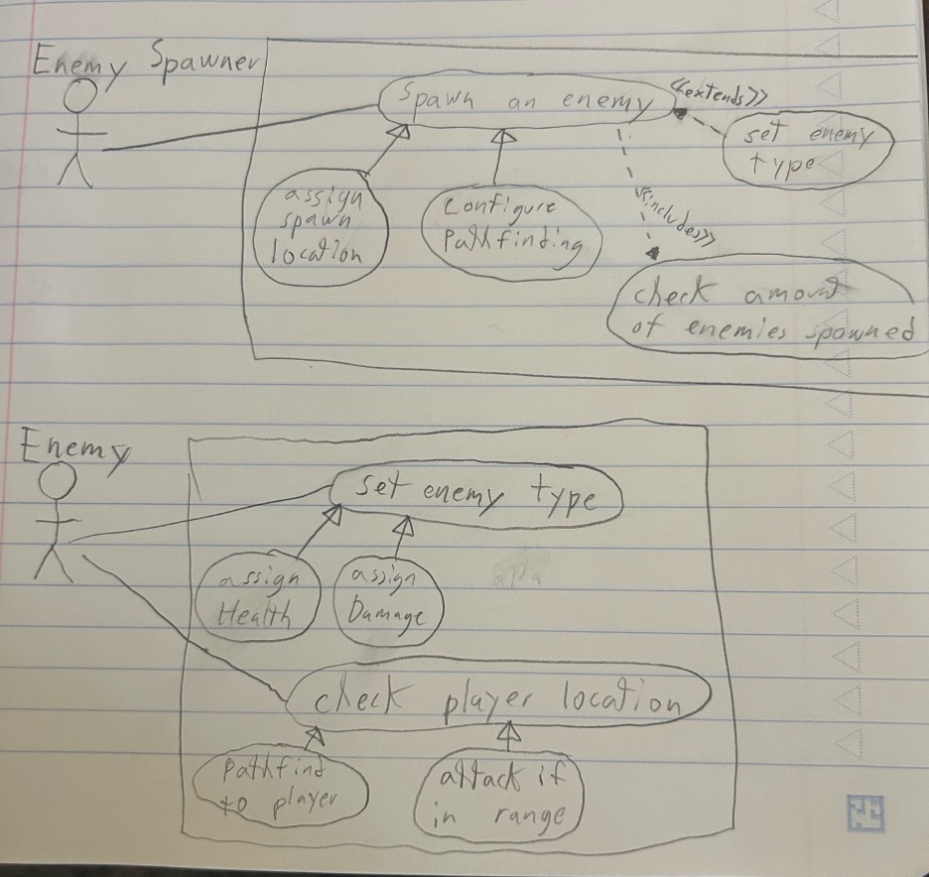
Miles Kison

Slide 45
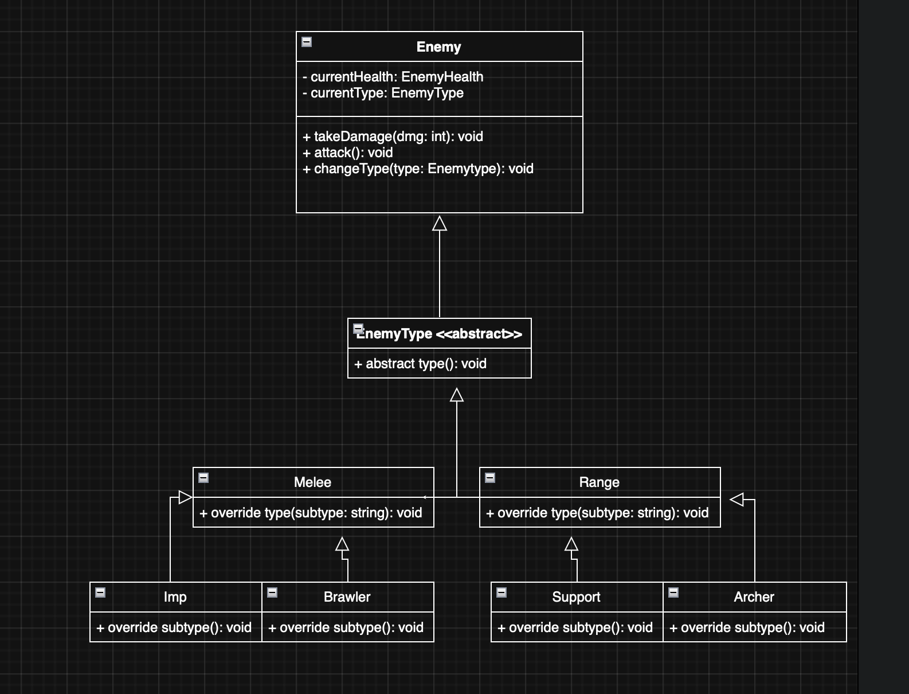
Miles Kison

Slide 46
Final Questions

Slide 47

Final Questions

